Slide 1



GOJECK
THE DRIVER ALLOCATION PROBLEM
Optimize allocation for GoRide
PRESENTED BY:
DIPIN RAJ
INTERN 04

Slide 2

INTRODUCTION
Problem Statement: Improving a model that predicts which driver is most likely to accept a ride request, with the ultimate goal of optimizing ride allocations.
The core task is to solve a driver allocation problem for Gojek's GoRide service.
When a customer books a ride, the system needs to decide which driver to send the booking notification to.
The primary business objective is to increase the number of accepted orders.
We had to build a model that predicts the best driver for a given order, where "best" implies the highest likelihood of accepting the booking.

Slide 3
PROBLEM INTERPRETATION
We were given an incomplete machine learning pipeline created by a junior data scientist. Our role, as a senior data scientist, is to:
Fix the Pipeline: Debug and fix the entire ML pipeline (data processing, feature engineering, training, prediction) so that it runs end-to-end using the provided Makefile commands (make data, make features, etc.).
Improve Model Performance: Make at least one significant change to improve the model's performance. This could be through feature engineering (which we've already started), hyperparameter tuning, or using a different model.
Deliver Predictions: The final output of your pipeline should be a results.csv file that maps an order_id to the driver_id your model has

Slide 4
METHODOLOGY
SETUP ENVIRONMENT
DATA PREPROCESSING
FEATURE ENGINEERING
For the environment setup initially we had to install Conda and then run the pipeline on the conda’s environment
The make_dataset.py carried out the essential preprocessing steps like merging, duplicate removal, and defining target columns was done
The transform.py file carried out the feature engineering and transformation steps, new feature like day of week and driver historical acceptance was created.

Slide 5
METHODOLOGY
MODEL TRAINING ON TRAIN
PREDICTION ON TEST
To prevent data leakage, predictions were made strictly on a sequestered test file, and the driver IDs who has a higher acceptance was saved in a csv file.
Models were initialized in classifier.py also I did add few more models like Logistic Regression, Decision Tree directly into the train.py

Slide 6
RESULTS
RESULTS ON TRAIN SET
The model comparison evaluated random_forest_tuned, logistic_regression, and Decision_tree algorithms, selecting the random_forest_tuned model as the best overall performer due to its highest ROC AUC score of approximately 0.863. Despite the Decision_tree having a slightly better accuracy and F1 score, the random_forest_tuned model was chosen, likely because ROC AUC was prioritized as the key performance metric.
RESULTS ON TEST SET
The predict_model.py script's primary function is to apply the trained model to new, unlabeled data and output the results to a results.csv file. This output file, containing the model's predictions of the best drivers to allocate. As the test data is unlabeled, the script cannot calculate performance metrics like accuracy or precision; these were instead computed during the training phase using a validation set.

Slide 7
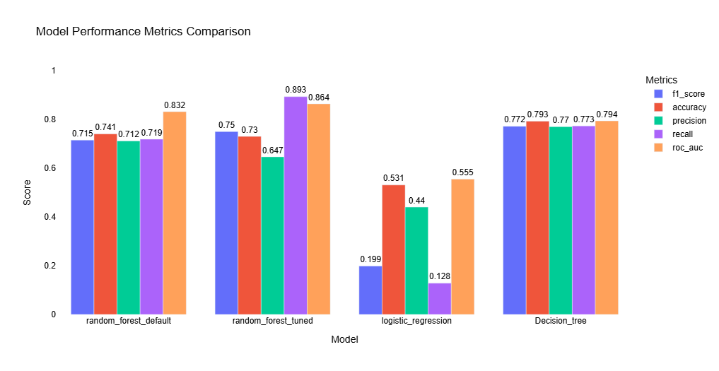
RESULTS VISUALIZATION

Slide 8
WHAT WOULD HAVE BEEN DONE?
API Deployment: Transition from a simple CSV output to serving predictions via a REST API (FastAPI) for real-time application access.
Robust Testing: Expand testing to cover the entire pipeline with integration and regression tests for increased stability.
Feature Engineering: Explore adding more predictive features, such as real-time traffic conditions, weather data, or driver historical performance metrics, to improve model accuracy.
Feature Importance Analysis: Use techniques to analyze feature importance, which could provide business insights into key drivers of optimal driver allocation.
Centralized Config: Improve configuration management to ensure all parameters are unified, flexible, and validated. Model Explainability: Utilize libraries like SHAP or LIME to explain model decisions, building trust and aiding debugging.

Slide 9
CHALLENGES AND IMPROVEMENTS
CHALLENGES AND LEARNING
FUTURE IMPROVEMENTS
Implement MLflow for experiment tracking and use GitHub Actions for a CI/CD pipeline to improve efficiency and reproducibility. Use SHAP or LIME to explain model predictions, which is vital for debugging and building user trust.
A key challenge was preventing data leakage between training and testing data, which reinforced the need for a strict, structured MLOps workflow. Learned that the "best" model is use-case specific, leading to the decision to prioritize ROC AUC over raw accuracy in the final model selection.

Slide 10

THANK YOU!

